Slide 1


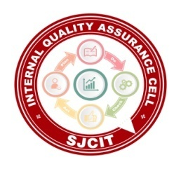
||Jai Sri Gurudev || Adichunchanagiri Shikshana Trust(R.) SJC INSTITUTE OF TECHNOLOGY An Autonomous Institution under VTU from 2024-25 AICTE Approved, Accredited by NBA(CSE,ISE,ECE,ME,CV,AE) NAAC with A+ grade, QS I-Gauge Gold rated P.B. No. 20, B.B. Road, Chikkaballapur- 562101, Karnataka.
Project- BCI685
On
“Intelligent Simulation Framework for Autonomous Vehicles ”
Presented by:
PRIYANSHU KUMAR
PUSHPAK CHAKRABORTY
RAJATH K M
TRUPTI GARWAD
DEPARTMENT OF ARTIFICIAL INTELLIGENCE & MACHINE LEARNING
Under the guidance of :
Prof. Muniraju M
Assistant Professor
Dept. of AI & ML, SJCIT

Slide 2
.
TABLE OF CONTENTS
Introduction
Abstract
Problem statement
Objective
Methodology

Slide 3
.
Introduction
The evolution of autonomous vehicles marks a transformative shift in modern transportation systems, aiming to enhance road safety, traffic efficiency, and passenger convenience. However, deploying such systems in real-world scenarios remains a formidable challenge due to the need for intelligent, adaptive, and robust decision-making capabilities. Achieving reliable navigation under dynamic traffic conditions requires more than just traditional path planning — it necessitates integration with advanced artificial intelligence techniques, reliable communication frameworks, and energy-aware sensor networks.
This project focuses on the development of a simulation-based framework that integrates multiple cutting-edge technologies to address these challenges. By combining Deep Reinforcement Learning (DRL), classical planning algorithms (A*, RRT*), Vehicle-to-Everything (V2X) communication protocols, and Wireless Sensor Network (WSN) optimization, the framework provides a holistic approach to adaptive path planning and cooperative autonomous driving. Simulation platforms such as CARLA, SUMO, and NS-3 are used to validate and demonstrate the effectiveness of this integrated system, ensuring scalability, responsiveness, and safety in highly dynamic environments.

Slide 4
.
Abstract
The proposed system presents an advanced, integrated simulation framework aimed at tackling the multi-dimensional challenges faced in autonomous vehicle navigation and control. As self-driving systems become increasingly complex, the need for robust, intelligent, and adaptive path planning that can operate reliably in uncertain and dynamic environments has grown substantially. This framework leverages a hybrid approach by combining Deep Reinforcement Learning (DRL) for intelligent decision-making with traditional algorithms like A* and RRT* for deterministic baseline path generation.
To ensure seamless inter-vehicle communication, the system incorporates Vehicle-to-Everything (V2X) technologies enhanced with groupcasting and IR-HARQ protocols, improving message reliability under delay and packet loss conditions. Moreover, the integration of Wireless Sensor Network (WSN) optimization using Reinforcement Learning and MOISA (Multi-Objective Improved Seagull Algorithm) addresses the challenge of energy-efficient data aggregation, making the framework scalable and resource-conscious.
Simulations are carried out using high-fidelity platforms such as CARLA and SUMO, allowing for realistic urban driving environments and detailed traffic behavior modeling. The system also includes comfort-aware modules based on Full Velocity Difference (FVD) models and employs formal verification through Signal Temporal Logic (STL) to enforce safety constraints and behavioral correctness at runtime.
By fusing learning-based strategies, classical optimization techniques, network-aware communication, and formal methods, this project aims to deliver a comprehensive, modular platform for simulating and validating autonomous driving behaviors. The ultimate goal is to bridge the gap between theoretical models and real-world deployability by ensuring adaptive performance, explainability, and operational safety in mixed-traffic, sensor-constrained, and unpredictable driving scenarios.

Slide 5
.
Problem Statement
Problem Statement:-
Current autonomous vehicle systems face major challenges in achieving real-time adaptability, safety, communication reliability, and energy-efficient decision-making under dynamic traffic and environmental conditions. While path planning approaches based on traditional algorithms or Deep Reinforcement Learning (DRL) offer partial solutions, they struggle with generalization, interpretability, and real-world deployment. Similarly, 5G/6G-enabled V2X communication and Wireless Sensor Networks (WSNs) improve simulation metrics but lack integrated, resilient, and intelligent frameworks in real-world mixed traffic environments. A unified system that combines adaptive learning-based motion planning, formal safety guarantees, reliable communication, and energy-aware routing is crucial to bridge this gap and enable robust, scalable, and sustainable autonomous vehicle operation.

Slide 6
.
Objective
The main goals of this project are:
• Adaptive Path Planning: Develop a hybrid global-local path planning system using DRL and traditional planners (A*, RRT*) to respond to dynamic environments.
• Vehicle-to-Vehicle Communication (V2X): Implement reliable 5G/6G-based communication using IR-HARQ and groupcasting for cooperative driving.
• Real-Time Replanning: Integrate MPC for continuous trajectory adjustments in response to obstacles and route changes.
• Comfort and Safety Control: Use Full Velocity Difference (FVD) model and feedback loops to ensure passenger stability and smooth motion.
• Energy-Aware WSN Integration: Optimize sensor networks using reinforcement learning and clustering with MOISA for efficient energy use.
• Formal Safety Verification: Apply Signal Temporal Logic (STL) to validate policy decisions and maintain adherence to safety constraints.

Slide 7
.
Methodology
The project will be implemented as a simulation-based system integrating the following modules:
Hybrid Path Planner:
Use A*/RRT* for initial path estimation.
DRL (e.g., PPO/SAC) for adaptive motion planning under uncertainty.
Replanning with MPC for local obstacle avoidance.
V2X Communication Module:
Develop groupcasting protocol with IR-HARQ retry schemes.
Implement packet delay/loss scenarios in SUMO + CARLA bridge.
Comfort and Control Module:
Integrate Full Velocity Difference (FVD) model with dynamic feedback gains.
Use STL to enforce safety zones and rule compliance.
WSN Energy Management:
Apply RL-based clustering and MOISA for energy optimization.
Use NS-2/NS-3 to simulate network load and routing dynamics.
Unified Decision and Logging Layer:
Build centralized integration logic.
Use STL-based runtime monitors to verify policy actions.

Slide 8
.
Design/Algorithm/Techniques Used
Deep Reinforcement Learning (PPO, SAC): Used for adaptive global path planning in dynamic environments.
A and RRT* Algorithms:* Classical techniques for initial path estimation and deterministic route generation.
Model Predictive Control (MPC): Applied for local real-time trajectory correction and obstacle avoidance.
Full Velocity Difference (FVD) Model: Ensures passenger comfort by minimizing acceleration and deceleration fluctuations.
Signal Temporal Logic (STL): Used for formal runtime verification of safety rules and behavioral constraints.
IR-HARQ-Based V2X Groupcasting: Enhances communication reliability and responsiveness between vehicles using 5G/6G.
MOISA (Multi-Objective Improved Seagull Algorithm): Optimizes energy-efficient routing and cluster formation in Wireless Sensor Networks (WSNs).

Slide 9
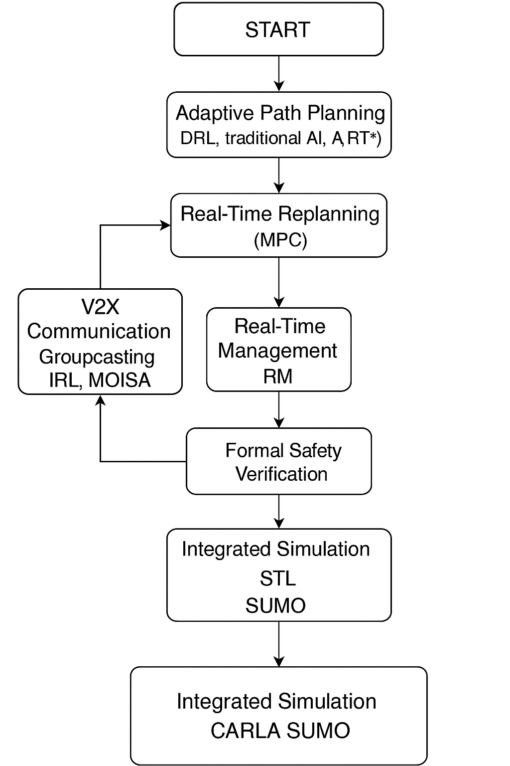
.
Flow Chart

